Slide 1
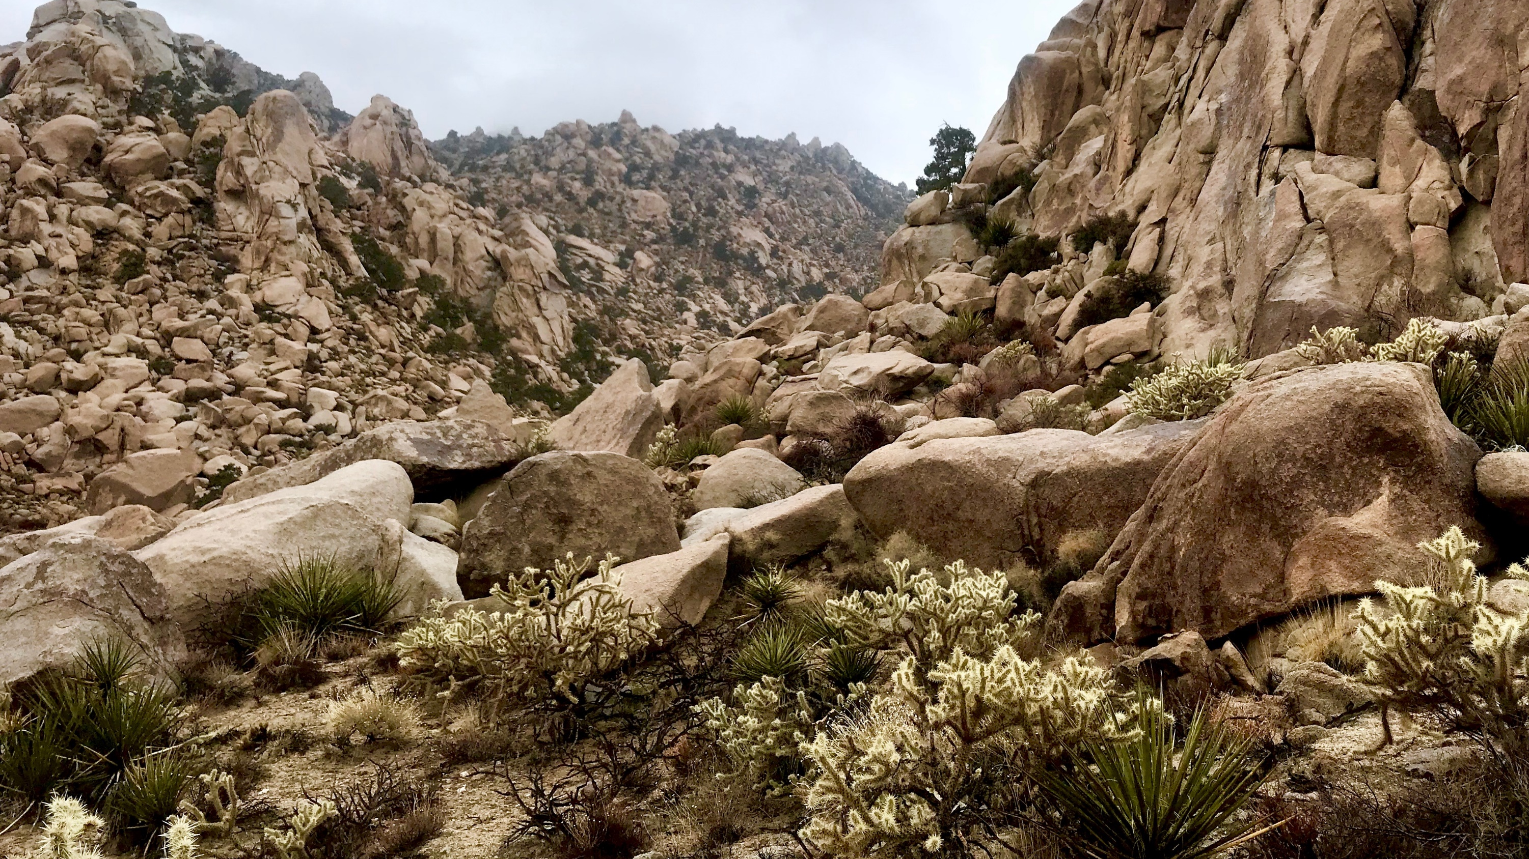
Pollination and Seed Dispersal of Cactaceae by Avian Interactors
Malory Owen & Christopher Lortie
Spring 2019 Progress Report

Slide 2
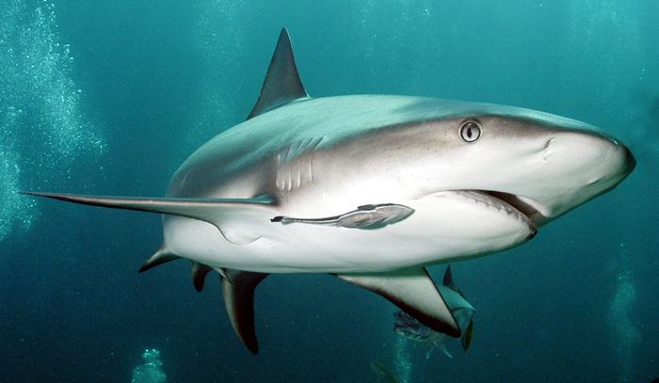
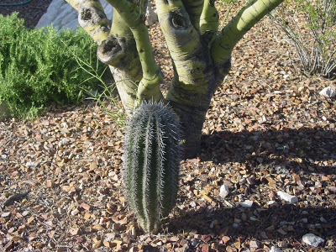
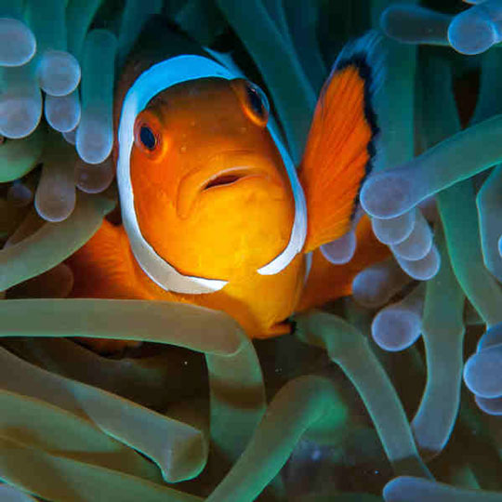
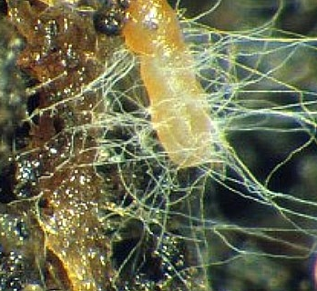
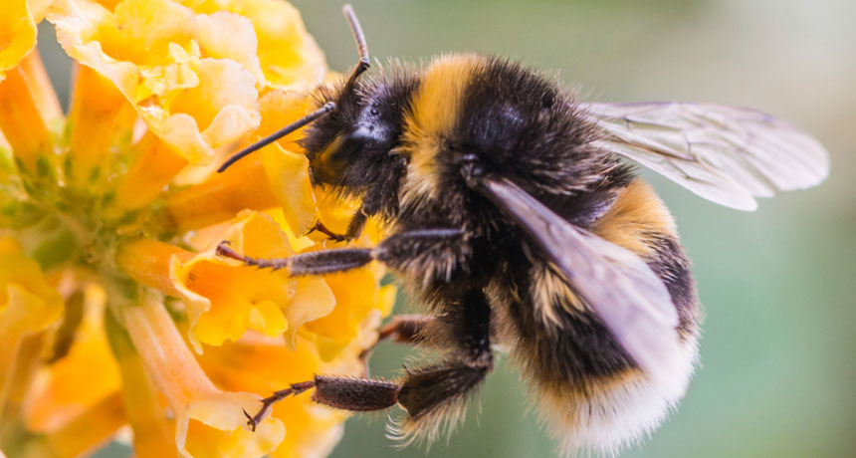
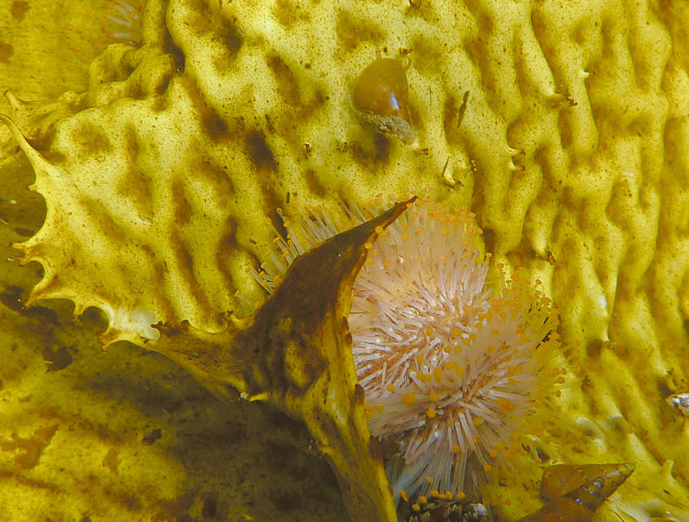
Shark and remora, shrub and cactus, clownfish and anemone,, mycorrhizae, bee and flower, kelp, gastropod, and sea urchin
Notes:
Positive interactions take many forms.
Pathways
Mutualism vs facilitation

Slide 3
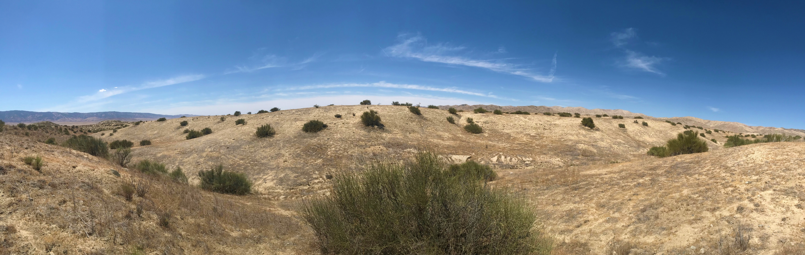
Notes:
When a species facilitates many other species in an ecosystem and becomes a dominant species, it’s known as a foundational species. Shrub species documented as the most common benefactor plant species globally (above is Ephedra californica).

Slide 4
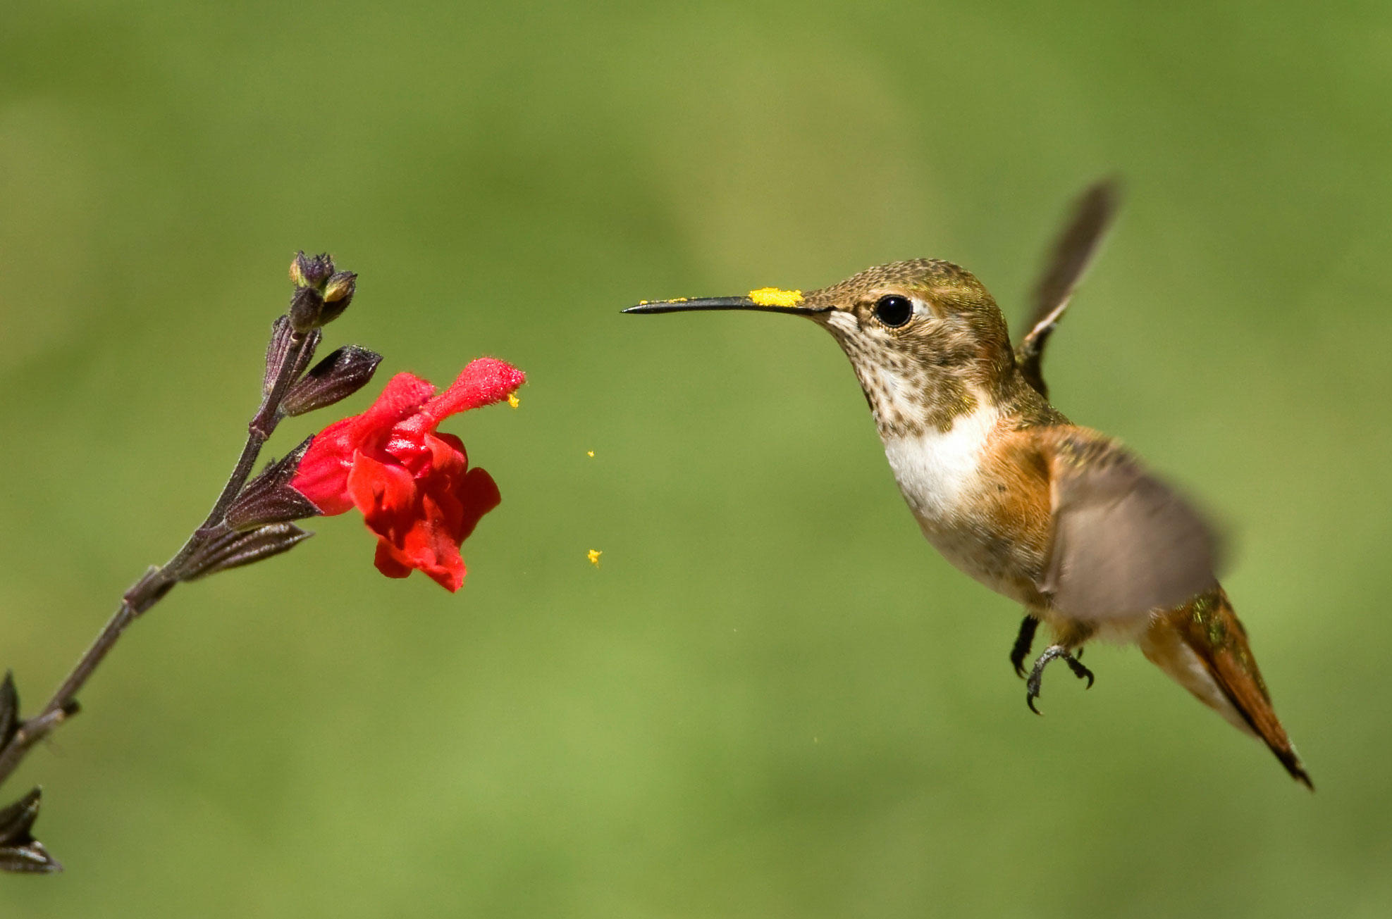
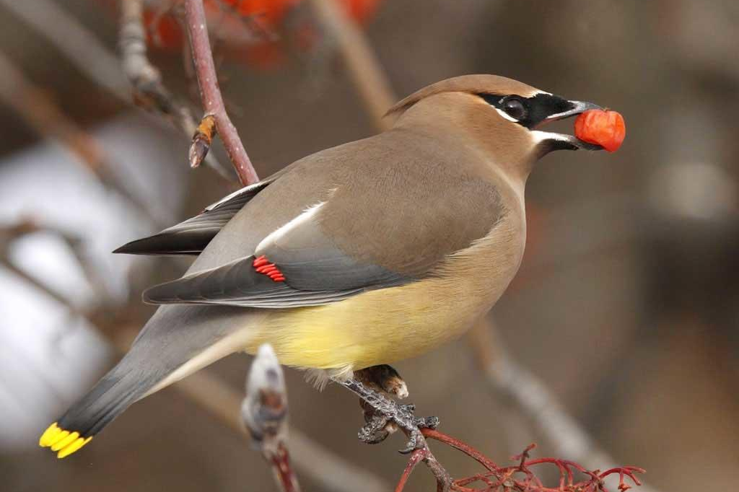
Mutualism
Mutualism
Same habitat
Same interactors
Double Mutualism
Hummingbird, waxwing
Notes:
Double mutualism;
Birds pollinate plant, then disperse the seed
Makes bird vectors for sexual reproduction of plants.
Most common in “harsh” climates: islands/deserts.
Cacti, being foundational ssp in deserts, may be utilizaing double mutualism…

Slide 5

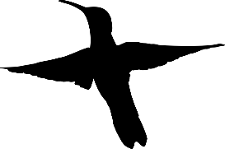

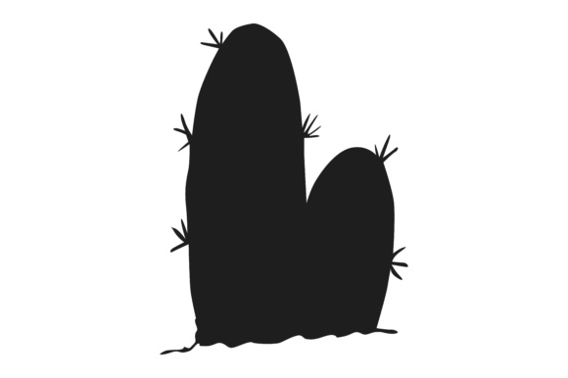



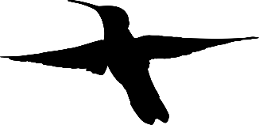
Notes:
So what is an advantageous adaption for cactus? Showier displays (more flowers) attract more pollinators/seed dispersers. Higher inflorescenses attract more pollinators/seed dispersers (flying individuals).
Foragers in patchy ecosystems function under marginal value theory where they will forage in one spot until the resource availability at that spot is equal to/lower than the entire habitat’s resource availability (then they will move on). This value is known as Giving Up Density (GUD). This leads us to believe cacti will produce many flowers/fruits, and be very tall. However, this isn’t the whole picture…

Slide 6

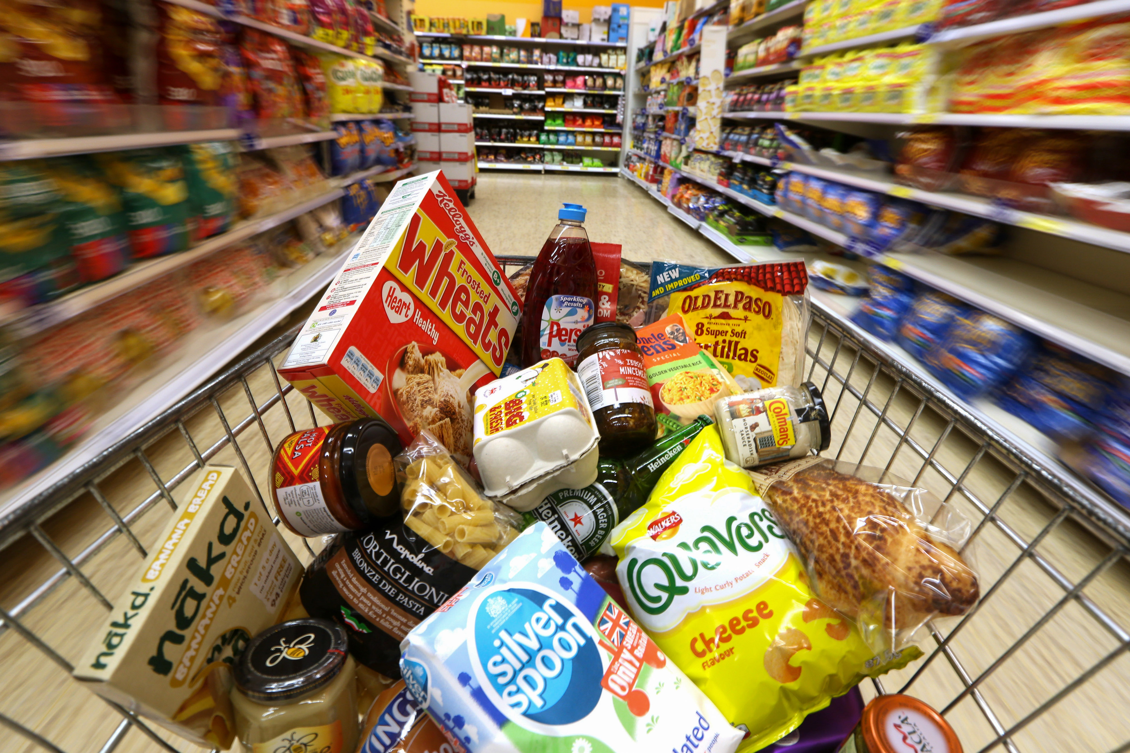
Notes:
Tradeoffs. Finite amount of money, have to allocation funds to rent and food, but you might have to make compromises (close to subway, hard wood floors, big windows, safe neighborhood versus fresh fruits/veggies, lots of food, name brand). Plants also make these tradeoffs with their energy.

Slide 7

Medium flower production
Medium Height
Plants must make tradeoffs to maximize two mutually exclusive structures
Notes:
We believe plants will make these tradeoffs to maximize pollinator/seed disperser interactions.

Slide 8
Chapter 1: A meta-analysis of physical allocation in Cactaceae reproductive structures
Purpose: Review literature on Cactaceae reproduction outputs, analyze reported values, and determine research gaps and future directions for agro-eco investigations.
Research Questions:
Are reproductive outputs in Cactaceae (flowers, fruits, and seeds) correlated?
How does Cactaceae phylogenetic distance related to reproductive output?
Where are Cactaceae reproductive studies relative to native and nonnative Cactaceae locations?
What research gaps exist in Cactaceae allocation research, and what opportunities for agro-eco interdisciplinary work have been unexplored?
Notes:
Give audience a moment to read slides. TLDR: Is allocation theory justified in Cactaceae?

Slide 9
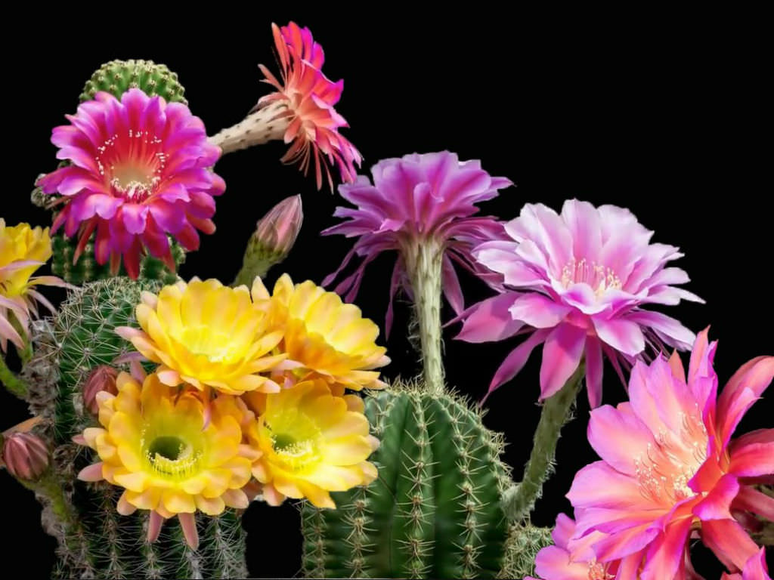
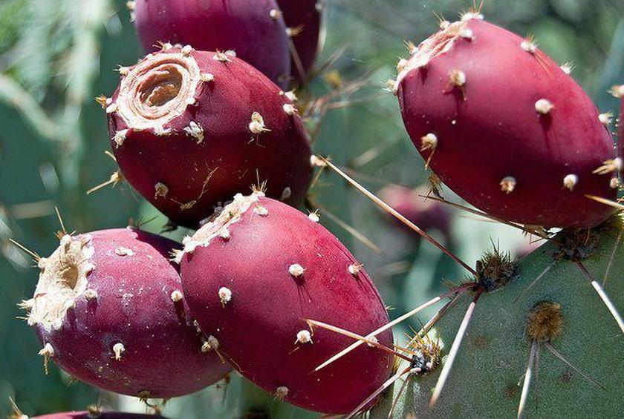
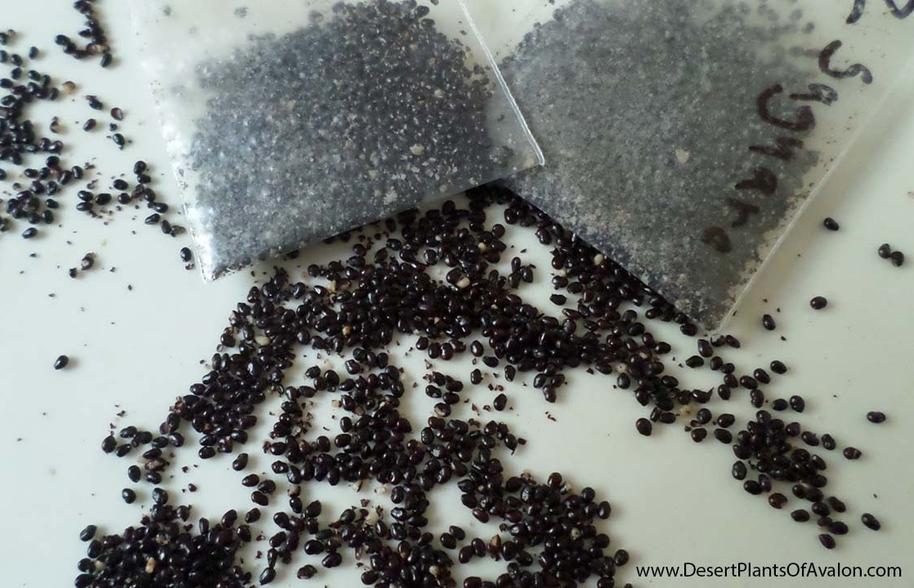
Hypothesis
Flower production will be greater than but correlated to fruit production. However, fruit production will be negatively correlated with seed production. Abundance of fruit or seeds will also be negatively correlated with mass of fruit or seeds, respectively.
Flower, fruit, seed

Slide 10
Methods
Completed:
Systematic Review
Web of Science
Future:
Add flower* to search terms
Older papers
Analyze in R package “metafor”
Search | Terms | Hits | Refines
1 | cact* and allocat* | 25 | topic, last five years
2 | cact* and fruit* and size | 63 | topic, last five years
3 | cact* and seed and fruit* | 110 | topic, last five years, articles
4 | cact* and seed and size | 53 | topic, last five years
5 | fruit* and seed and size and allocat* | 69 | topic, last five years
6 | cact* and size and allocat* | 10 | topic, last five years
7 | cact* and fruit and agricultur* | 18 | topic, last five years
 | total | 348

Slide 11
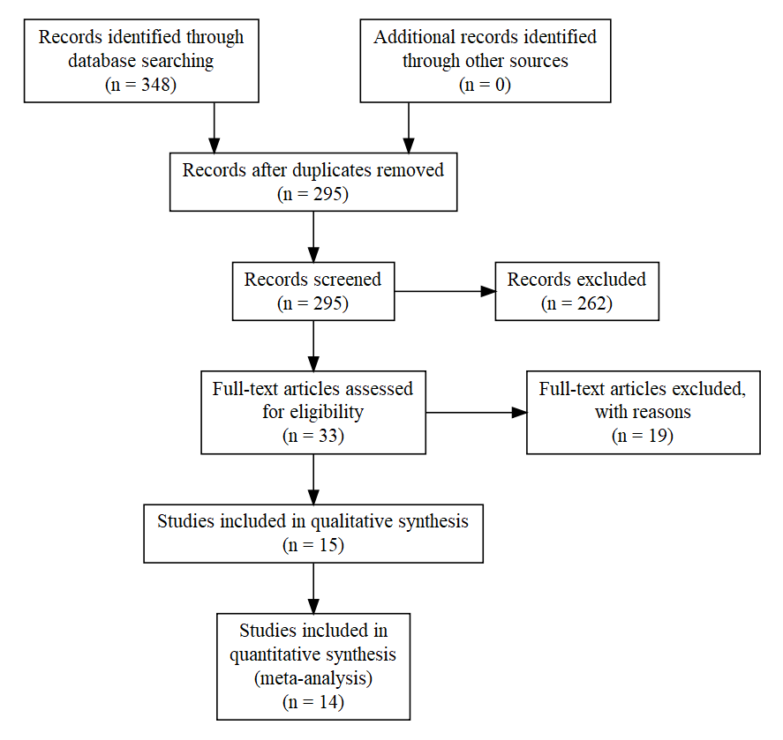

Slide 12
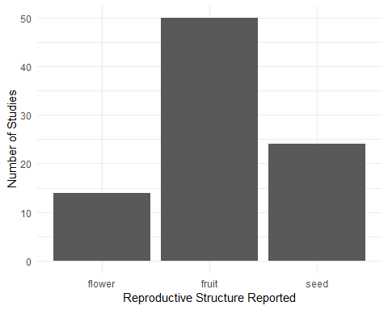
Preliminary Results
Notes:
Fruit is the most frequently reported reproductive structure, but I believe adding “Flower” to search terms will drastically increase the number of reported flowers

Slide 13
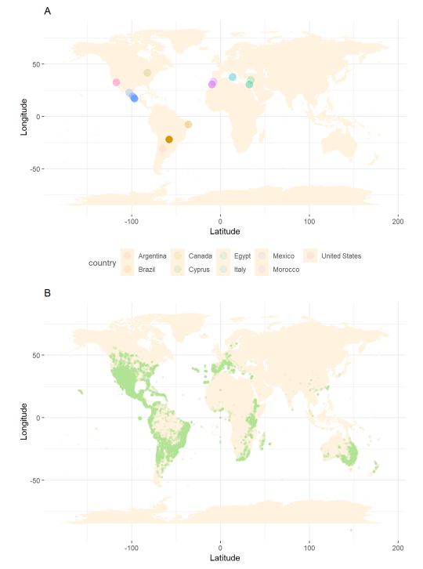
Preliminary Results
Notes:
Cacti are native to western hemisphere (except for one species in Africa), but introductions have created invasive species, and agricultural products have made the family present globally.

Slide 14
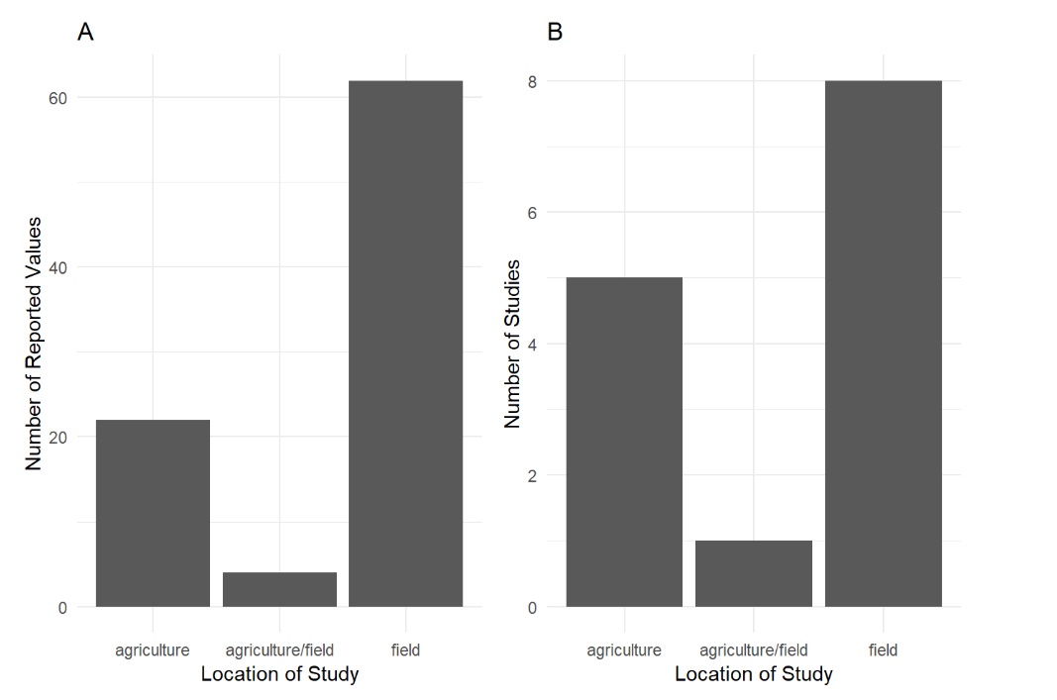
Preliminary Results
Notes:
Most studies are relevant to agricultural and ecological sciences, but there is little overlap in subdisciplines. From the systematic review, methodology differs significantly between disciplines. With this part of my project, I’d like to work towards bridging the gap between these two fields.

Slide 15
Chapter 2
Purpose: The aim of this study is to determine the strength of this double mutualistic interaction between birds and a foundational species of cactus based on morphological characteristics of cactus individuals.
Research Questions:
Are reproductive structures of cacti correlated with each other or with Cylindropuntia acanthocarpa volume?
What Avian communities are associated with C. acanthocarpa?
How strong are Avian-C. acanthocarpa double mutualistic interactions?
Notes:
Give audience a moment to read the slides. TLDR: Describe the interaction between birds and C. acanthocarpa.

Slide 16
Hypothesis & Predictions
Hypothesis: C. acanthocarpa individuals that maximize size and reproductive output via allocational tradeoffs will have the showiest reproductive displays, and therefore the most pollinating and seed dispersing Avian visitors.
Predictions:
Flower and fruit production will be positively correlated, but cactus volume and reproductive output will be negatively correlated.
Avian visitation rates and diversity are dependent on cactus morphological characteristics.
Avian diversity at a C. acanthocarpa individual is different than avian diversity at the entire site.
Notes:
Give audience time to read slides. TLDR: next slide

Slide 17
Medium flower production
Medium Height
Notes:
Remember this? We hypothesize that this is the trade off we will see.

Slide 18
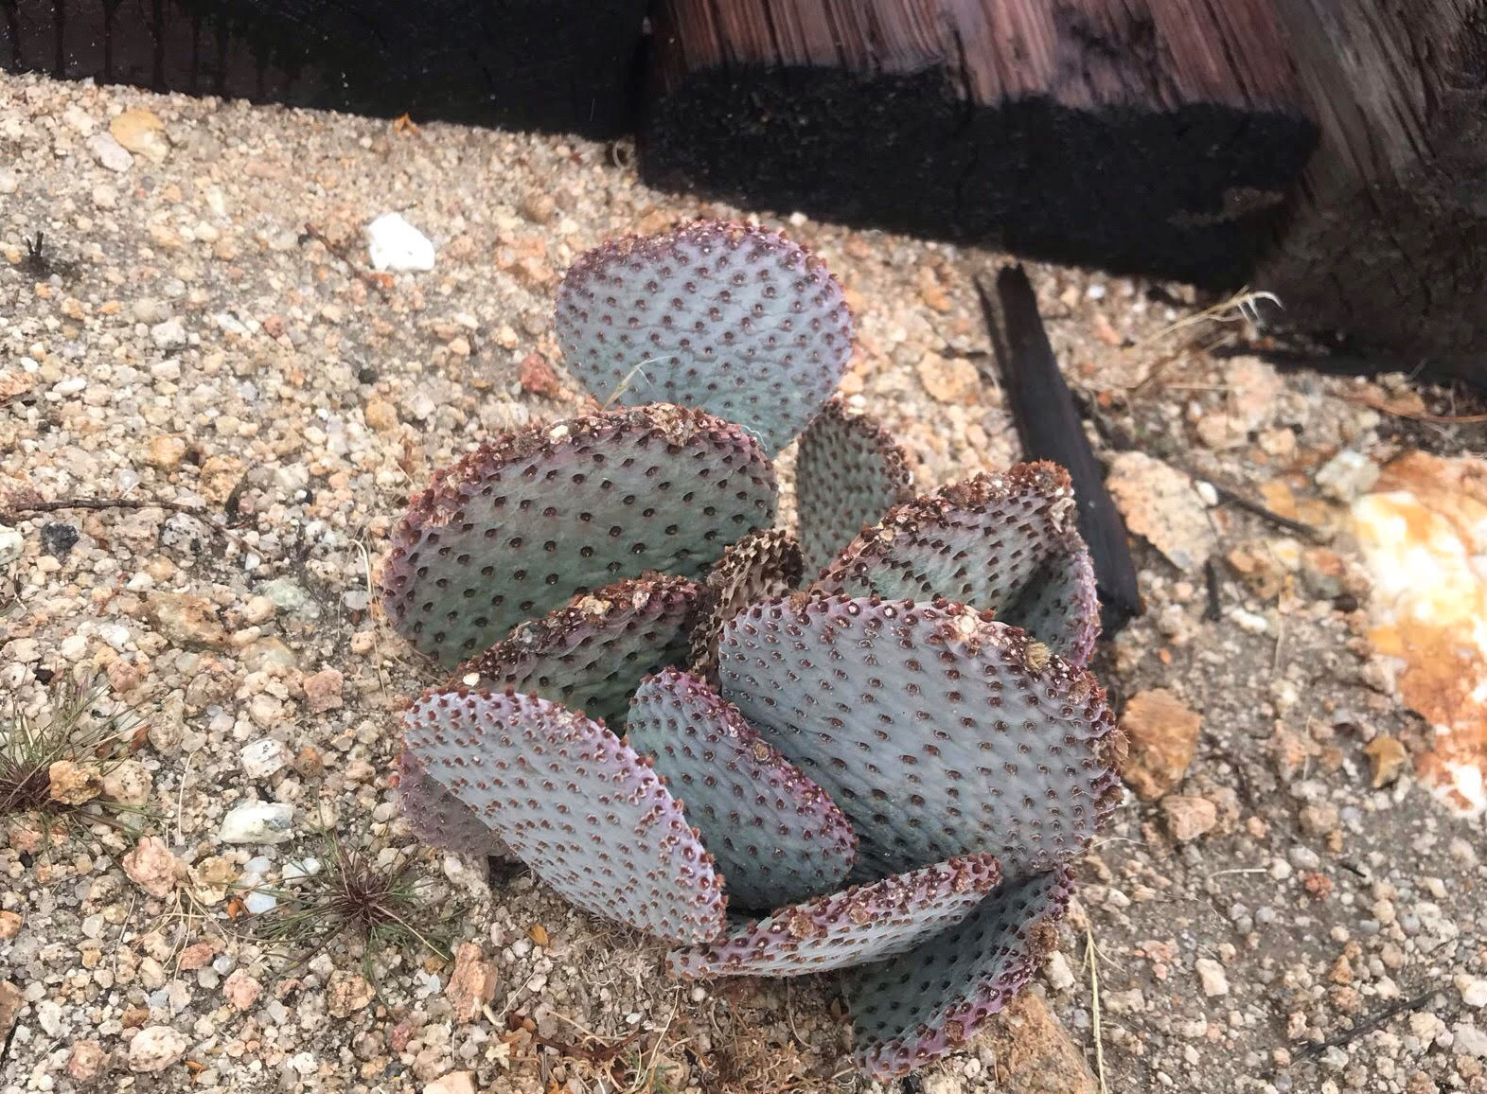
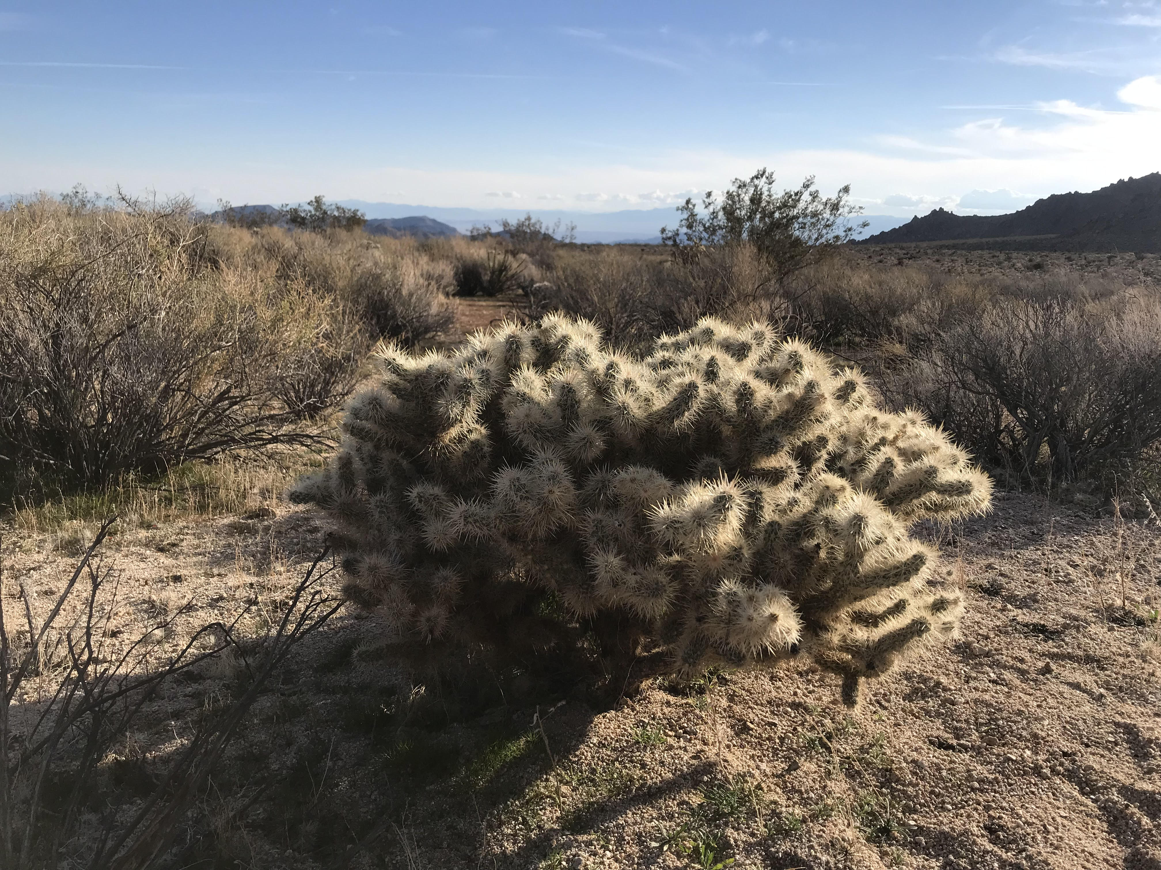
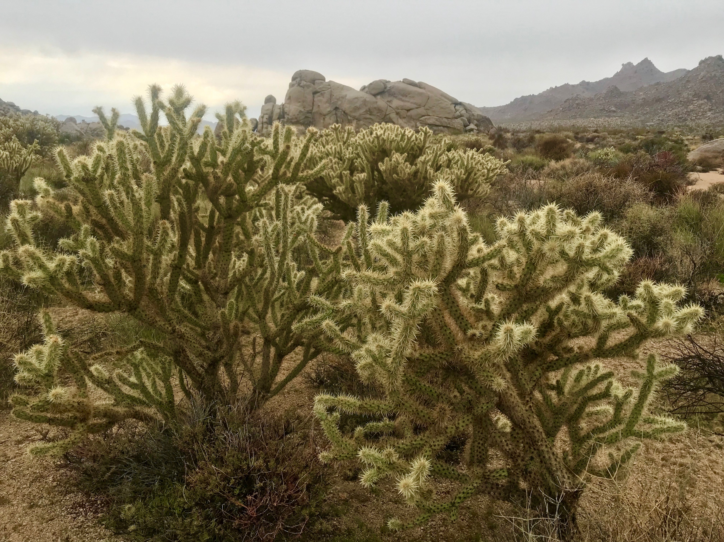
Methods: Preliminary Cactus Survey
Cylindropuntia acanthocarpa, Cylindropuntia echinocarpa, & Opuntia basilaris
Transects or haphazard
Major, minor, and vertical axes measured
Health index (1-5)
Branch death, rot, and scarification

Slide 19
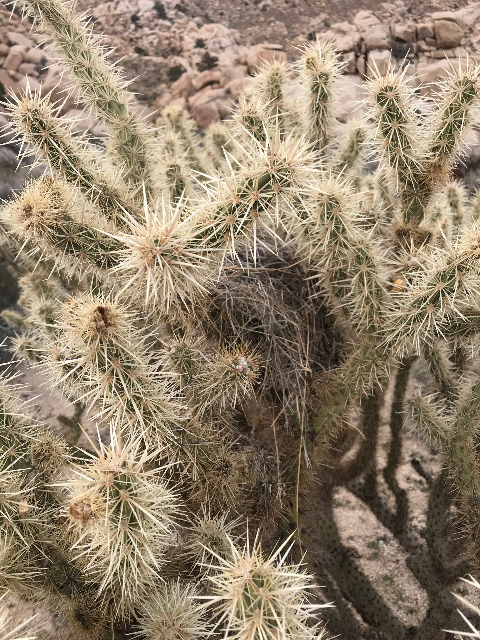
Methods: Experimental Manipulations
Cylindropuntia acanthocarpa
Small, medium, large class sizes
0%, 25%, 50%, 75%, 100% flowers or fruits removed
7 replicates (105 total cacti, 3.5 hours per day)
1 hour focal observations
Ethogram
Species/behavior identification aided by 150-600mm digital camera
Measure sucrose content in flowers
Weigh fresh fruit and seeds

Slide 20
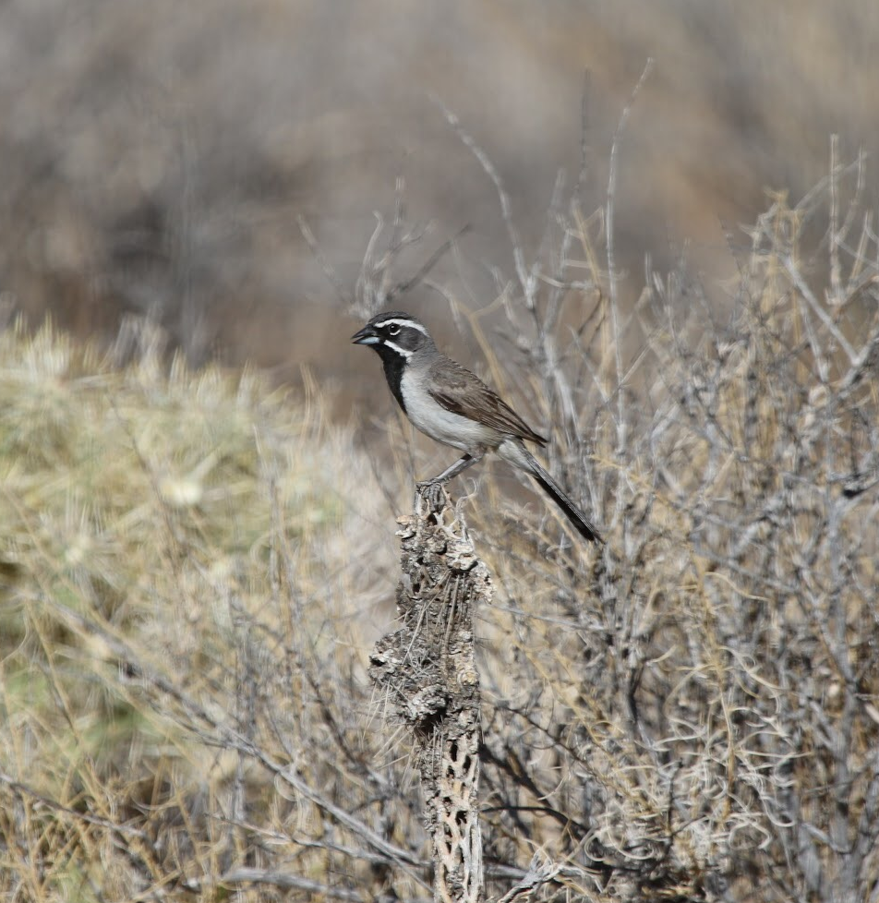
Methods: Joy Sampling
Area search
50 hours total (2 hour sessions)
Mesohabitat
Geotag
Point count
50 hours total (2 hour sessions)
Monitor one cactus
Notes:
Question: should I only monitor cacti for point count, or split into different mesohabitats? (open, shrub)

Slide 21
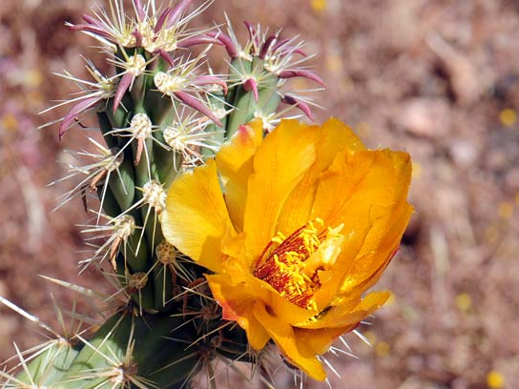
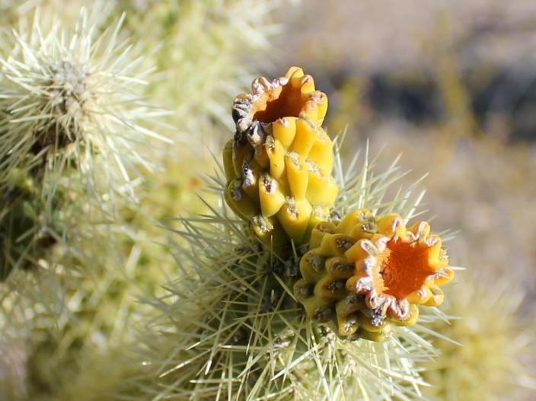
Paired Observations
20 cactus individuals
Geotag
Count flowers in May, fruit in August
Flower, fruit
Notes:
Monitor to determine link between flowers and fruit (same indivdiuals)

Slide 22
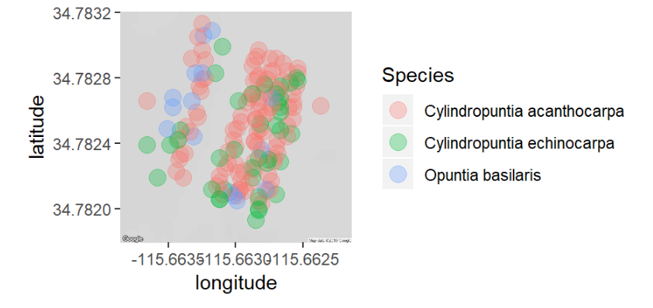
Preliminary Results: Location
Notes:
C. Acanthocarpa was most dense

Slide 23
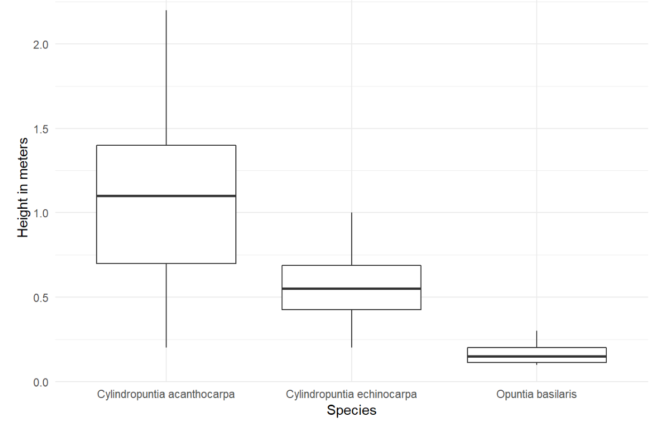
Preliminary Results: Size
Kruskal-Wallis, Chi-square = 3.71, p > 0.0001, df = 52
Means heights of 1.04 meters for C. acanthocarpa, 0.55 meters for C. echinocarpa, and 0.17 meters for O. basilaris

Slide 24
Preliminary Results: Size Class
Species | Small | Medium | Large
Cylindropuntia acanthocarpa | <85cm | 86cm - 152cm | >153cm
Cylindropuntia echinocarpa | <45cm | 46cm - 72cm | >73cm
Opuntia basilaris | <15cm | 16cm - 22cm | >23cm
Notes:
C. Acanthocarpa had the widest size classes. This is important bc it may more clearly translate to how birds are viewing differences in size

Slide 25
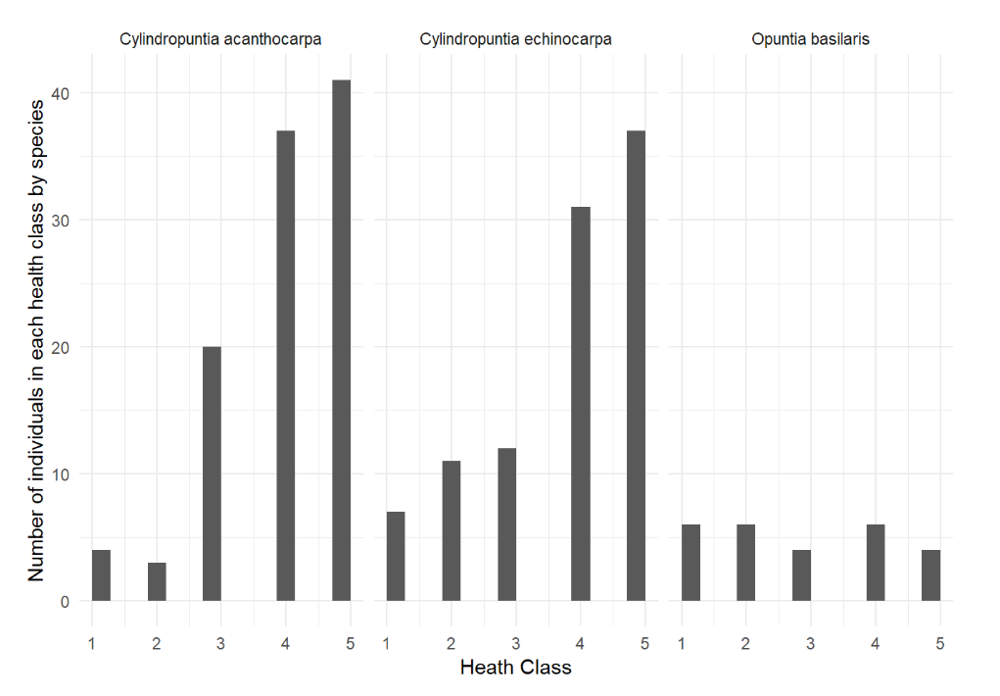
Preliminary Results: Health
Pearson’s Chi-squared Test, X-squared = 27.325, df = 8, p > 0.001
 | 1 | 2 | 3 | 4 | 5
C. acanthocarpa | 4 | 3 | 20 | 37 | 41
C. echinocarpa | 7 | 11 | 12 | 31 | 37
O. basilaris | 6 | 6 | 4 | 6 | 4

Slide 26
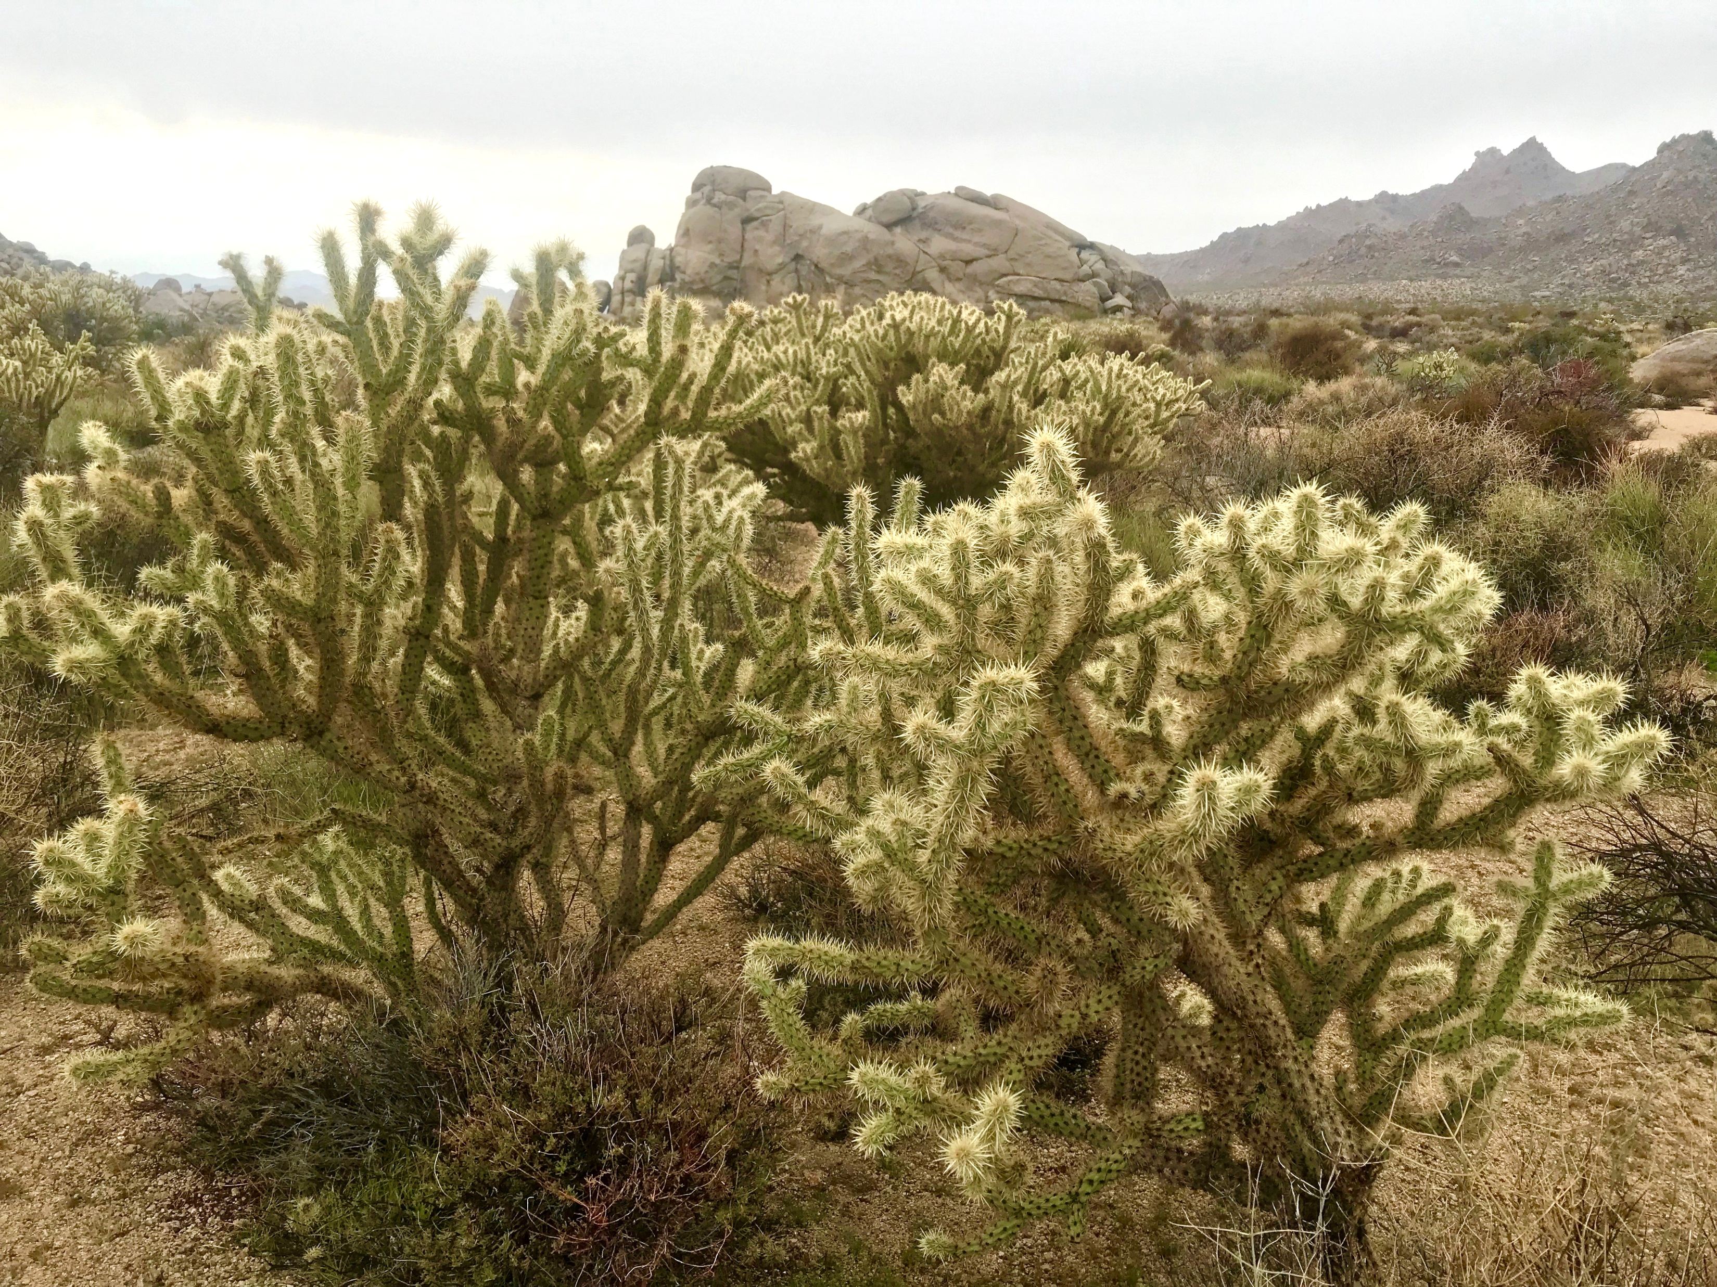
Discussion
Abundance, size, and health were “strongest” in C. acanthocarpa
One study species > three study species
Likely foundational species
Notes:
We need abundance for replications in May and August, size to translate to birds, and health to encourage strong flowering

Slide 27
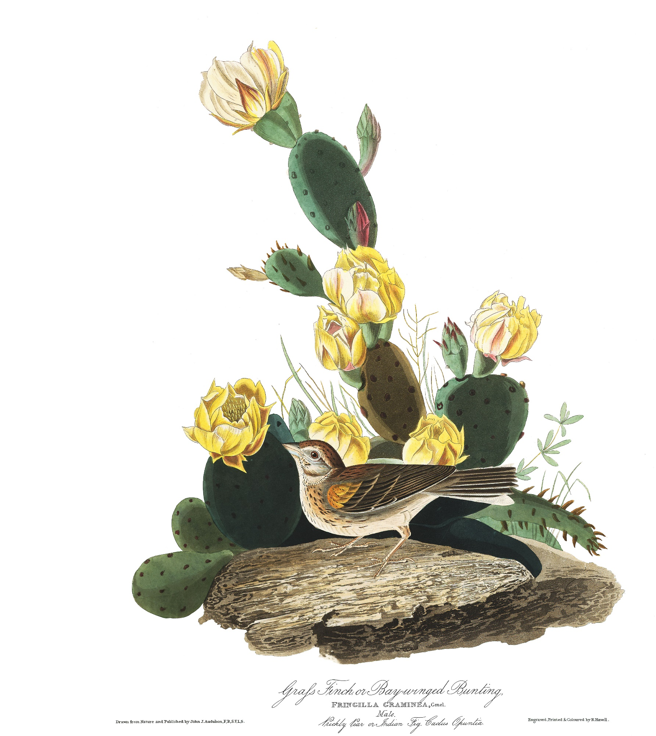
Looking forward
Mega-bloom year
C. acanthocarpa facilitation experiments
Shrub/cactus mapping
Notes:
Mega bloom year bc high rain means lots of cactus flowers, some cool oppurtunties in that
Follow up with pollinator facilitation experiments by Jenna two years ago during last mega bloom, but now during cactus blooming instead of annual blooming
Map all cacti and shrubs at Sunset cove (undergrad help)

Slide 28
If we understand:
Positive Interactions
Habitat Structure
Restoration/Protection of Deserts
Notes:
Deserts are diverse (not wastelands) in decline bc climate change, human development, and invasive species. All Cactaceae are listed on CITES Appendix II, with several ssp on Appendix I.
This project will help us understand how positive interactions influence habitat structure, and therefore combat habitat loss.
Restoration work has primarily focus on abiotic factors of habitat structure, but if we can identify biotic vectors of habitat creation and maintanence, this project potentially has the capacity to revamp the toolbox available to practioners.

Slide 29
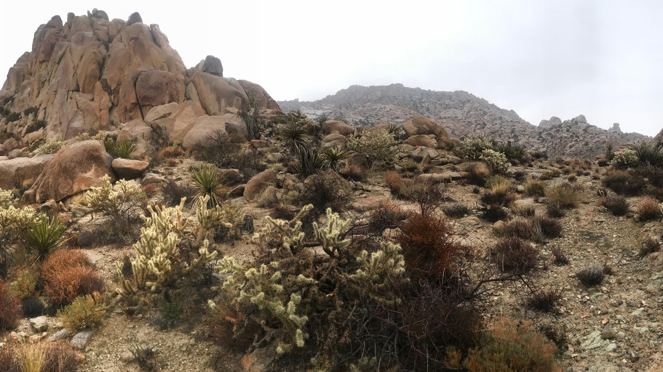
Thanks for listening!

